Slide 1
Data Mining
Instructor: Dr. Atif Khan

Slide 2
●
K nearest neighbors is a simple algorithm that stores all available cases and classifies new cases based on a
similarity measure (e.g., distance functions)
KNN has been used in statistical estimation and pattern recognition already in the beginning of 1970’s
KNN is a simple classifier and very easy to implemne
●
Notes:
It uses similarity measures (distance function) to find nearest cases to the new case.

Slide 3
Algorithm
●
A case is classified by a majority vote of its neighbors, with the case being assigned to the class most common amongst its K nearest neighbors measured by a distance function
If K = 1, then the case is simply assigned to the class of its nearest neighbor
●
Notes:
Consider a point and set of points. We find distance between this point and all other points. Suppose we choose 5 nearest neighbors. So the point is assigned to class that is most common among the 5 neighbors.

Slide 4
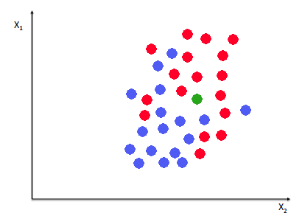
Diagram
Notes:
We want to visualize the data referring to weight(Y) and height(X) measurements of individuals(red for male and blue for female). Suppose we have new measurement green dot, we want to predict whether this individual is male or female. If we have k=1, the nearest neighbor to this is red dot, so it is male.
If we have k=5, we consider 5 nearest neighbors to this point, 3 red and 2 blue, 3>2 so majority class is male. K should be taken as odd to avoid ties.
If we have k=6, we can have 3 red and 3 blue, in that case, a class is chosen at random to avoid ties.

Slide 5
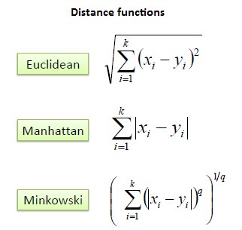
Distance measures for cont. variables(Numerical Data)
Notes:
Continuous variable or numerical variable.
Difference distance measures but Euclidean is the most common one.

Slide 6
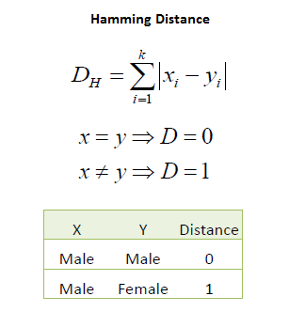
Categorical Variables
●
In the instance of categorical variables the Hamming distance must be used
It also brings up the issue of standardization of the numerical variables between 0 and 1 when there is a mixture of numerical and categorical variables in the dataset
●
Notes:
If the two categores(x,y) are same then d=0, if they are different then D=1, we need to standardize our data to get better results.

Slide 7
How many neighbors?
●
Choosing the optimal value for K is best done by first inspecting the data
In general, a large K value is more precise as it reduces the overall noise but there is no guarantee
Cross-validation is another way to retrospectively determine a good K value by using an independent dataset to validate the K value
Historically, the optimal K for most datasets has been between 3-10. That produces much better results than 1NN
●
●
●
Notes:
Choosing the vlaue of k is a problem.
Inspecting data means visualizing the data like graph/diagram. In general, a large value of k will give precise results,but no guarantee
We use different values of k on different evalution sets to get the best kvalue
Rule of thumb (from experience of researcher) k ranges from 3-10

Slide 8
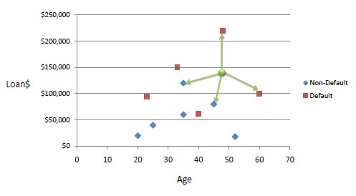
Example:
●
Consider the following data concerning credit default. Age and Loan are two numerical variables (predictors) and Default is the target
Notes:
The prediction is that the new point will be assigned to class default or non default given the age and loan data.

Slide 9
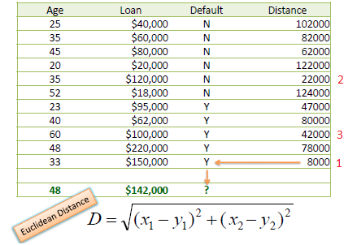
Example
●
We can now use the training set to classify an unknown case (Age=48 and Loan=$142,000) using Euclidean distance.
If K=1 then the nearest neighbor is the last case in the training set with Default=Y. D = Sqrt[(48-33)^2 + (142000-150000)^2] = 8000.01 >> Default=Y
●
●
●
With K=3, there are two Default=Y and one Default=N out of three closest neighbors. The prediction for the unknown case is again Default=Y
Notes:
2>1, majority is now is Yes. So new case is assigned to default =Yes.

Slide 10
Standardized Distance
●
One major drawback in calculating distance measures directly from the training set is in the case where variables have different measurement scales or there is a mixture of numerical and categorical variables.
For example, if one variable is based on annual income in dollars, and the other is based on age in years then income will have a much higher influence on the distance calculated.
One solution is to standardize the training set
●
●

Slide 11
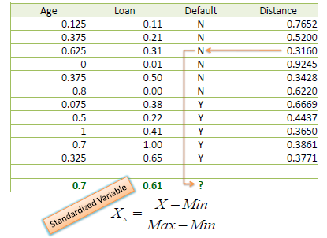
Standardized Distance
Using the standardized distance on the same training set, the unknown case returned a different neighbor which is not a good sign of robustness.
Notes:
Before standardizing,and using 1NN, the class was yes. After standardizing, accord to 1NN, the predicted class is no
=(33-20)/(60-20)=0.325
=(48-20)/(60-20)=0.7

Slide 12
To find k nearest neighbors of a new instance
- For classification it uses majority vote
- For regression it finds the mean (average)

Slide 13
Diagram
Notes:
We want to visualize the data referring to weight(Y) and height(X) measurements of individuals(red for male and blue for female). Suppose we have new measurement green dot, we want to predict whether this individual is male or female. If we have k=1, the nearest neighbor to this is red dot, so it is male.
If we have k=5, we consider 5 nearest neighbors to this point, 3 red and 2 blue, 3>2 so majority class is male. K should be taken as odd to avoid ties.
If we have k=6, we can have 3 red and 3 blue, in that case, a class is chosen at random to avoid ties.

Slide 14
Distance measures for cont. variables
p1=(w1,x1,y1,z1), p2=(w2,x2,y2,z2)
Euc. Dist. (p1,p2) = sqrt((w1-w2)^2+(x1-x2)^2+(y1-y2)^2+(z1-z2)^2)

Slide 15
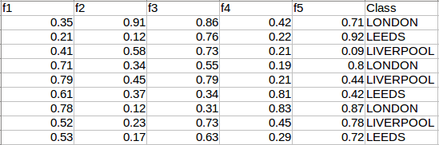
Example Dataset
Query 0.65
0.78
0.21
0.29
0.58 Class = ?
Notes:
We have 5 features/dimensions/descriptors/attributes/predictors along with class/category representing instances of dummy data.
Find eculidean distance of the instance query and all instances based on the correpodning dimensions
Sqr( (0.65-0.35)^2 + (0.78-0.91)^2 + (0.21-0.86)^2 + (0.29-0.42)^2 + (0.58-0.71)^2 )
Simlarly with other instances.
Sort the cities(class) in ascending order based on distances. If we have 5NN, then find the mode of the 5 nearest cities.

Slide 16
K Nearest Neighbors - Regression
K nearest neighbors is a simple algorithm that stores all available cases and predict the numerical target based on a similarity measure (e.g., distance functions).
KNN has been used in statistical estimation and pattern recognition already in the beginning of 1970’s as a non-parametric technique.
Algorithm:
A simple implementation of KNN regression is to calculate the average of the numerical target of the K nearest neighbors.
Another approach uses an inverse distance weighted average of the K nearest neighbors. KNN regression uses the same distance functions as KNN classification.

Slide 17
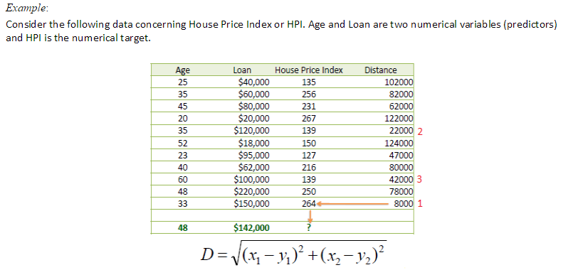
Notes:
A house price index (HPI) measures the price changes of residential housing as a percentage change from some specific start date (which has HPI of 100).

Slide 18
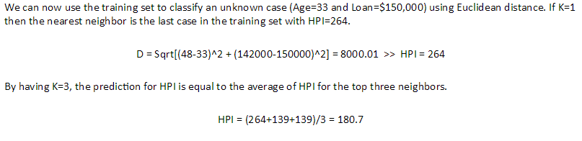

Slide 19
Regression
Regression is a data mining task of predicting the value of target(numerical attribute) by building a model based on one or more predictors (numerical & Categorical variables)

Slide 20
Decision Tree - Regression
Decision tree builds regression or classification models in the form of
a tree structure.
It breaks down a dataset into smaller and smaller subsets while at the
same time an associated decision tree is incrementally developed.
The final result is a tree with decision nodes and leaf nodes.
A decision node (e.g., Outlook) has two or more branches (e.g., Sunny, Overcast and Rainy), each representing values for the attribute tested.
Leaf node (e.g., Hours Played) represents a decision on the numerical target.
The topmost decision node in a tree which corresponds to the best predictor called root node.
Decision trees can handle both categorical and numerical data.

Slide 21
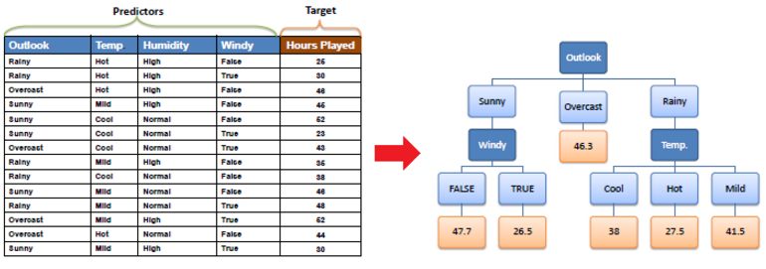
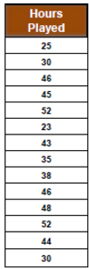
Example

Slide 22
Decision Tree-Algorithm
The core algorithm for building decision trees called ID3 by J. R. Quinlan which employs a top-down, greedy search through the space of possible branches with no backtracking.
The ID3 algorithm can be used to construct a decision tree for regression by
replacing Information Gain with Standard Deviation Reduction.
A decision tree is built top-down from a root node and involves partitioning the
data into subsets that contain instances with similar values (homogenous).
We use standard deviation to calculate the homogeneity of a numerical
sample.
If the numerical sample is completely homogeneous; its standard deviation is zero.

Slide 23
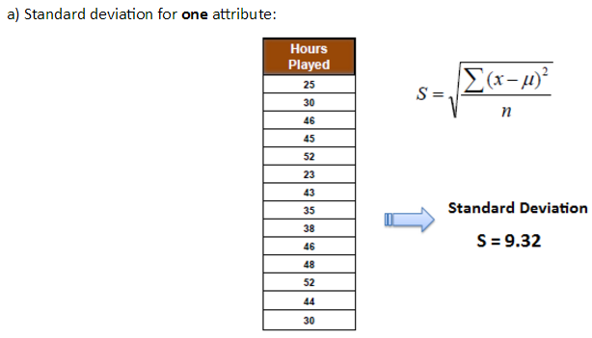
File for illustration

Slide 24
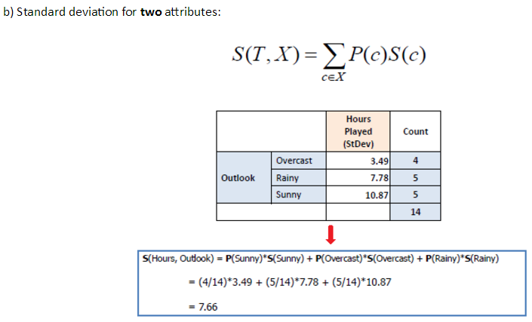

Slide 25
Standard Deviation Reduction
The standard deviation reduction is based on the decrease in standard deviation after a dataset is split on an attribute.
Constructing a decision tree is all about finding attribute that returns the highest standard deviation reduction (i.e., the most homogeneous branches).
Step 1: The standard deviation of the target is calculated. Standard deviation (Hours Played) = 9.32
Step 2: The dataset is then split on the different attributes. The standard deviation for each branch is calculated.
The resulting standard deviation is subtracted from the standard deviation before the split.
The result is the standard deviation reduction.

Slide 26
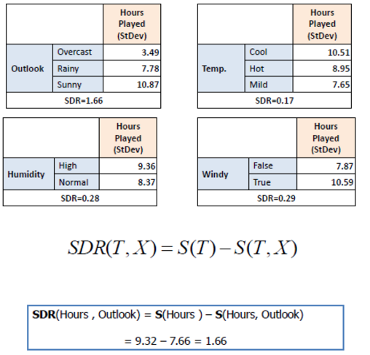

Slide 27
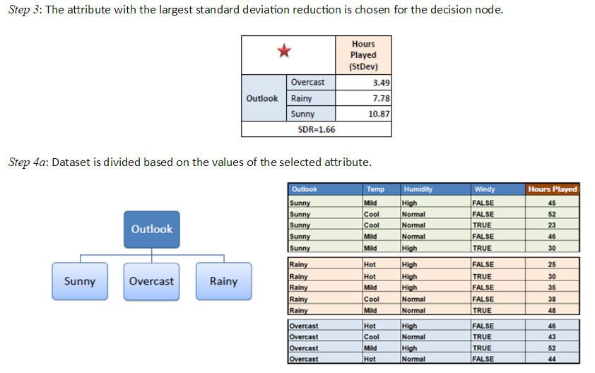

Slide 28
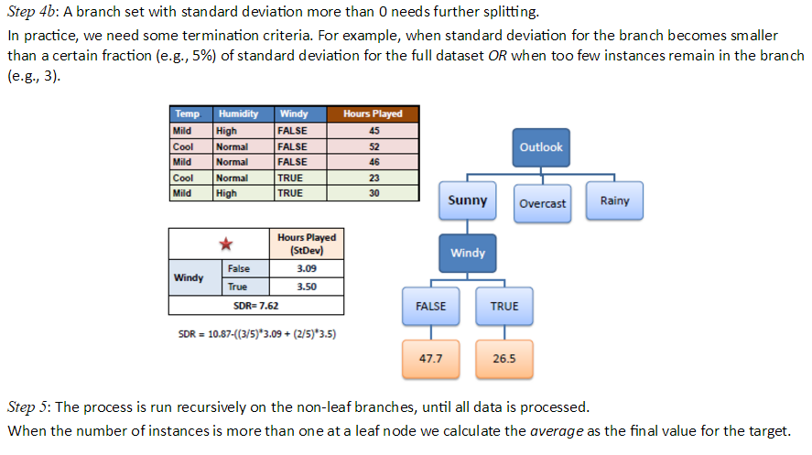
Notes:
=0.05*9.35=0.467
There are 3 sunny values against false, and two true values against true.. So averaged them to get a single value

